Slide 1
Java web - Servlet - section 02
Vo Hoang Long - TBV (TechGroup)

Slide 2
Agenda
sendRedirect()
Attribute servlet
Servlet Filter

Slide 3
SendRedirect in servlet
The sendRedirect() method of HttpServletResponse interface can be used to redirect response to another resource, it may be servlet, jsp or html file.
It accepts relative as well as absolute URL.
It works at client side because it uses the url bar of the browser to make another request. So, it can work inside and outside the server.

Slide 4
SendRedirect in servlet
Difference between forward() and sendRedirect() method
There are many differences between the forward() method of RequestDispatcher and sendRedirect() method of HttpServletResponse interface
forward() method | sendRedirect() method
The forward() method works at server side. | The sendRedirect() method works at client side.
It sends the same request and response objects to another servlet. | It always sends a new request.
It can work within the server only. | It can be used within and outside the server.
Example: request.getRequestDispacher("servlet2").forward(request,response); | Example: response.sendRedirect("servlet2");

Slide 5
Attribute in Servlet
An attribute in servlet is an object that can be set, get or removed from one of the following scopes:
request scope
session scope
application scope
The servlet programmer can pass informations from one servlet to another using attributes. It is just like passing object from one class to another so that we can reuse the same object again and again.

Slide 6
Attribute specific methods of ServletRequest, HttpSession and ServletContext interface
There are following 4 attribute specific methods. They are as follows:public void setAttribute(String name,Object object):sets the given object in the application scope.
public Object getAttribute(String name):Returns the attribute for the specified name.
public Enumeration getInitParameterNames():Returns the names of the context's initialization parameters as an Enumeration of String objects.
public void removeAttribute(String name):Removes the attribute with the given name from the servlet context.

Slide 7
Servlet Filter
A filter is an object that is invoked at the preprocessing and postprocessing of a request.
It is mainly used to perform filtering tasks such as conversion, logging, compression, encryption and decryption, input validation etc.
The servlet filter is pluggable, i.e. its entry is defined in the web.xml file, if we remove the entry of filter from the web.xml file, filter will be removed automatically and we don't need to change the servlet.
So maintenance cost will be less.

Slide 8
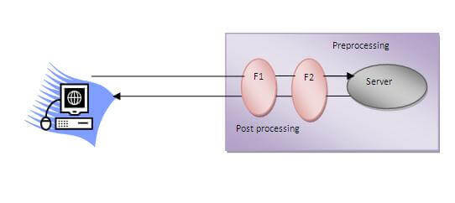
Servlet Filter

Slide 9
Servlet Filter
Usage of Filter
recording all incoming requests
logs the IP addresses of the computers from which the requests originate
conversion
data compression
encryption and decryption
input validation etc.
Advantage of Filter
Filter is pluggable.
One filter don't have dependency onto another resource.
Less Maintenance

Slide 10
Filter API
Like servlet filter have its own API. The javax.servlet package contains the three interfaces of Filter API.
Filter
FilterChain
FilterConfig

Slide 11
Filter API
Filter interface
For creating any filter, you must implement the Filter interface. Filter interface provides the life cycle methods for a filter.
Method | Description
public void init(FilterConfig config) | init() method is invoked only once. It is used to initialize the filter.
public void doFilter(HttpServletRequest request,HttpServletResponse response, FilterChain chain) | doFilter() method is invoked every time when user request to any resource, to which the filter is mapped.It is used to perform filtering tasks.
public void destroy() | This is invoked only once when filter is taken out of the service.

Slide 12
Filter API
FilterChain interface
The object of FilterChain is responsible to invoke the next filter or resource in the chain.This object is passed in the doFilter method of Filter interface.The FilterChain interface contains only one method:
public void doFilter(HttpServletRequest request, HttpServletResponse response): it passes the control to the next filter or resource.

Slide 13
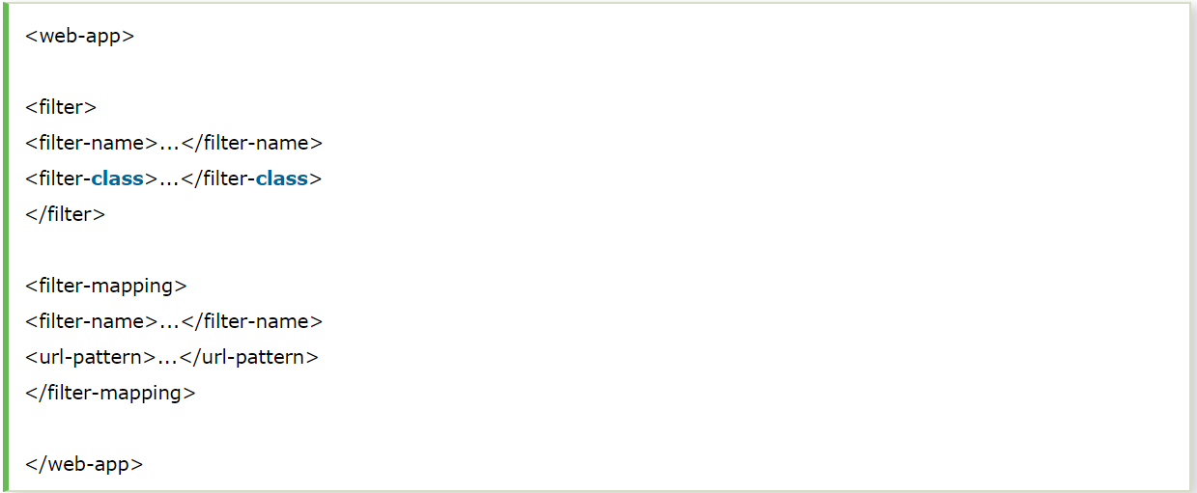
How to define Filter
We can define filter same as servlet. Let's see the elements of filter and filter-mapping.
For mapping filter we can use, either url-pattern or servlet-name. The url-pattern elements has an advantage over servlet-name element i.e. it can be applied on servlet, JSP or HTML

Slide 14
Authentication Filter
We can perform authentication in filter. Here, we are going to check to password given by the user in filter class, if given password is admin, it will forward the request to the WelcomeAdmin servlet otherwise it will display error message.
Example of authenticating user using filter
Let's see the simple example of authenticating user using filter.
Here, we have created 4 files:
admin-login.html
AdminFilter.java
AdminServlet.java
web.xml

Slide 15
FilterConfig
An object of FilterConfig is created by the web container. This object can be used to get the configuration information from the web.xml file.
Methods of FilterConfig interface
There are following 4 methods in the FilterConfig interface.
public void init(FilterConfig config): init() method is invoked only once it is used to initialize the filter.
public String getInitParameter(String parameterName): Returns the parameter value for the specified parameter name.
public java.util.Enumeration getInitParameterNames(): Returns an enumeration containing all the parameter names.
public ServletContext getServletContext(): Returns the ServletContext object.

